Slide 1
Introduction to R

Slide 2

What is
R is an open source programming language that is used for data manipulation, calculation and graphical display.

Slide 3
What you need to know about
It is open source: Its freely available, hence no need to buy the licence to use it.
R is an object oriented programming language.
The installation of it comes with pre-installed libraries for use in data manipulation, analysis and visualization.
You can install more libraries or even create your own functions to use in R.
It has an IDE called RStudio that makes it easy to interact with R.

Slide 4
What we will cover:
Introduction to R and installations.
Setting up your working environment.
Programming basics of R.
Data structures and data types.
Packages

Slide 5
How to install
Visit the r project website: https://cran.mirror.ac.za/
Choose package compatible with your pc;
Download R for linux.
Download R for macOS.
Download R for Windows.
Follow the instructions of installation. Choose the default options as you go through the installation window.

Slide 6

Installing
Visit the Download the RStudio IDE page: https://www.rstudio.com/products/rstudio/download/
Choose your version and download it.

Slide 7
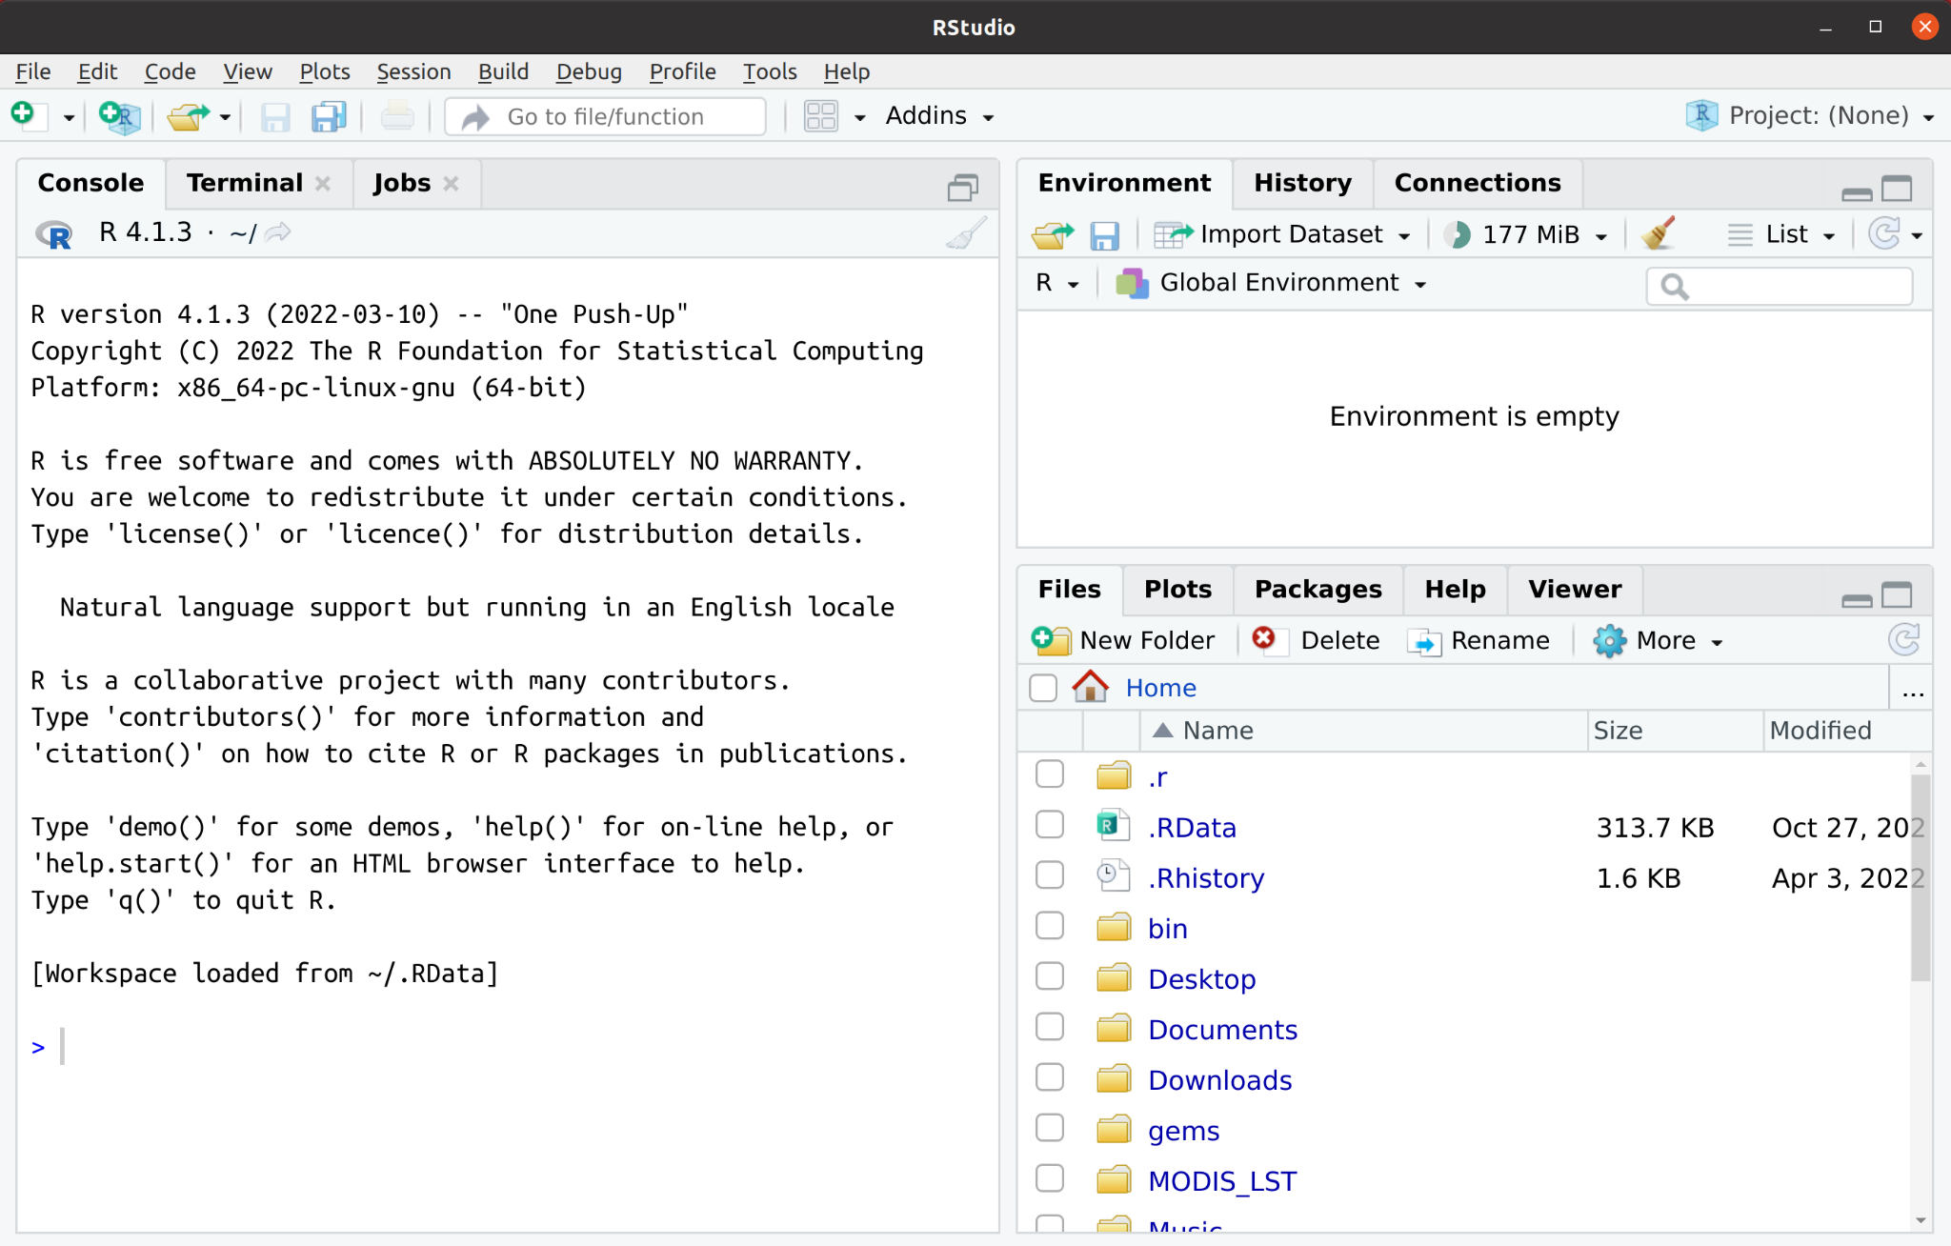
Launching RStudio

Slide 8
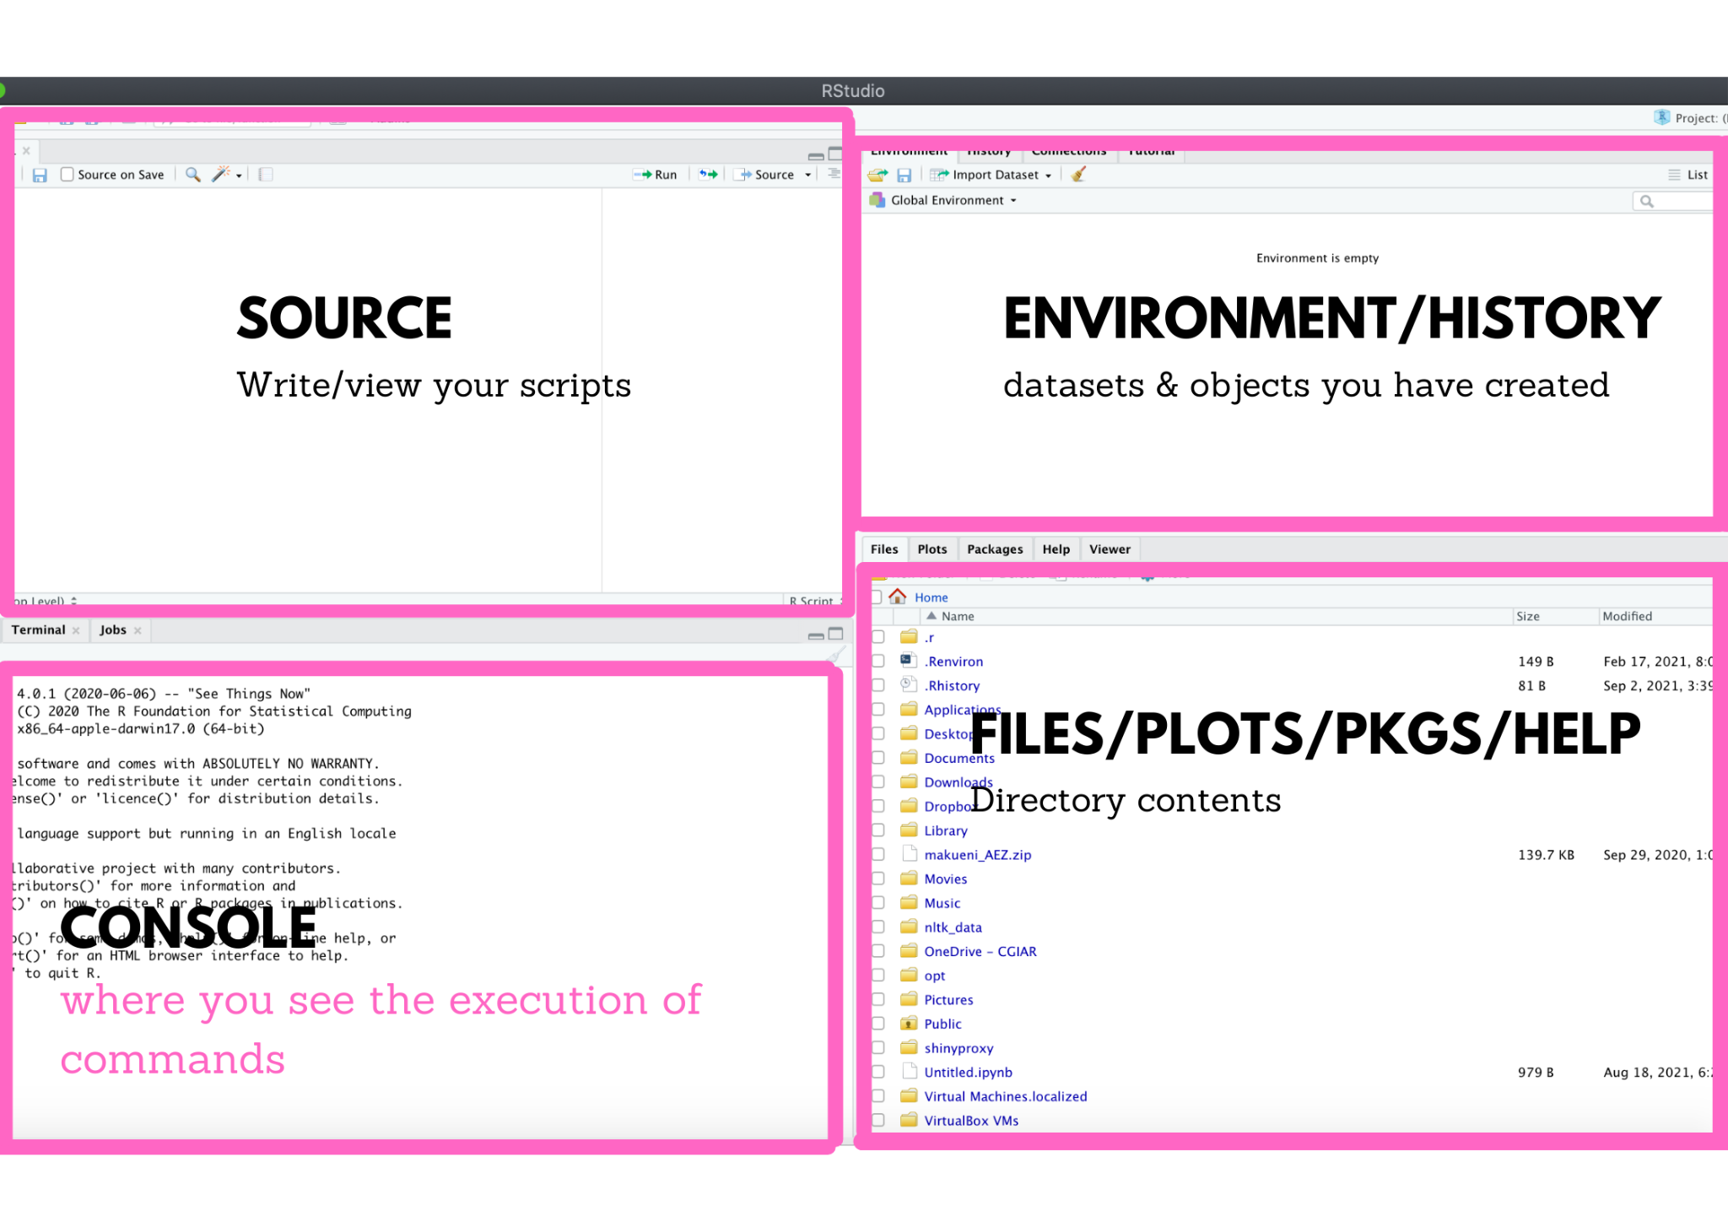
RStudio IDE

Slide 9
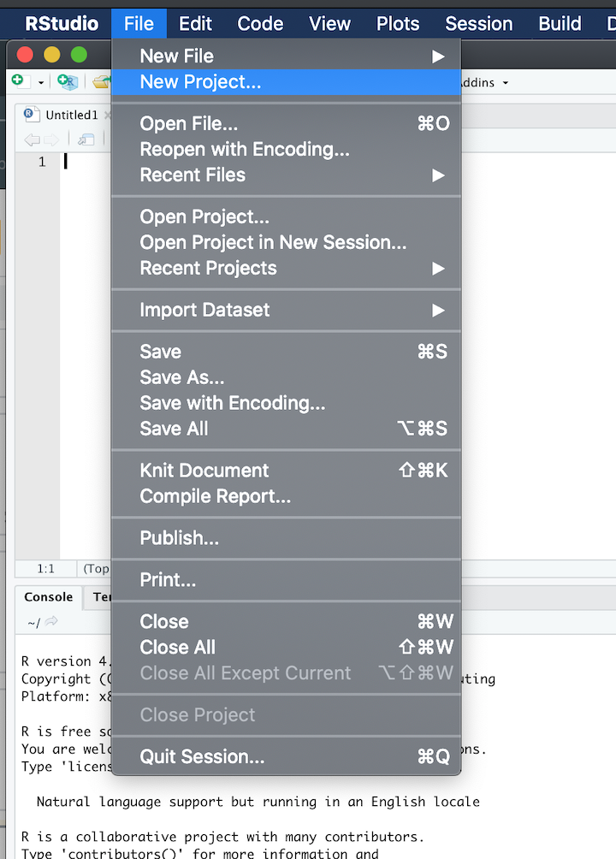
Setting up your working environment
Open RStudio
Navigate to:
File
New project

Slide 10
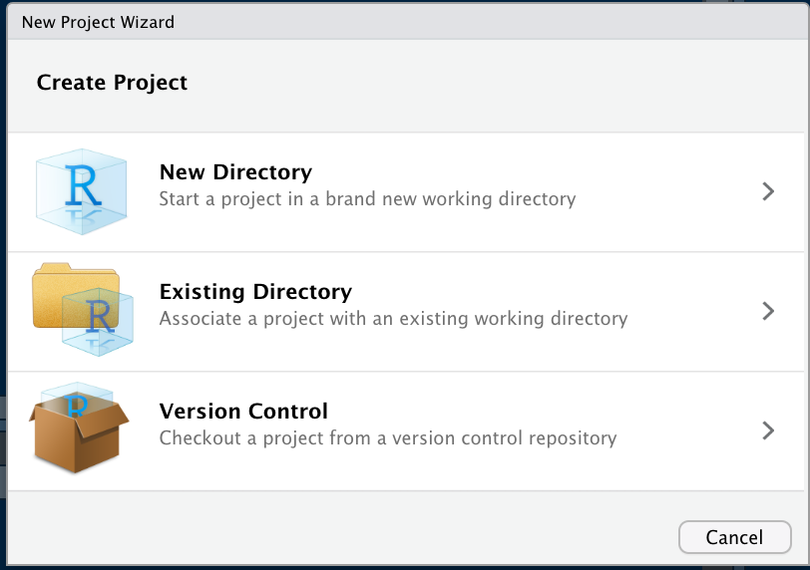
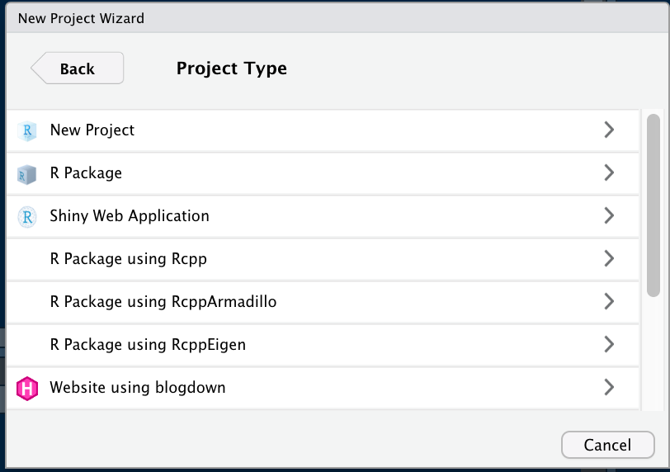
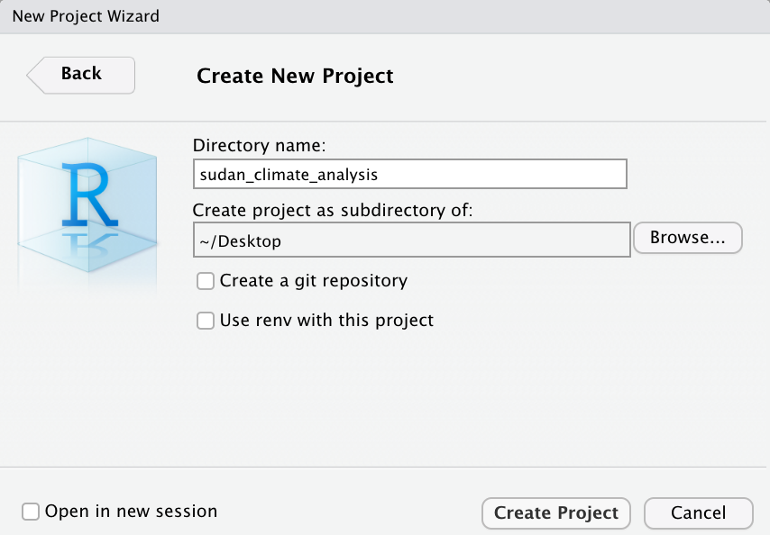
Creating your project directory

Slide 11
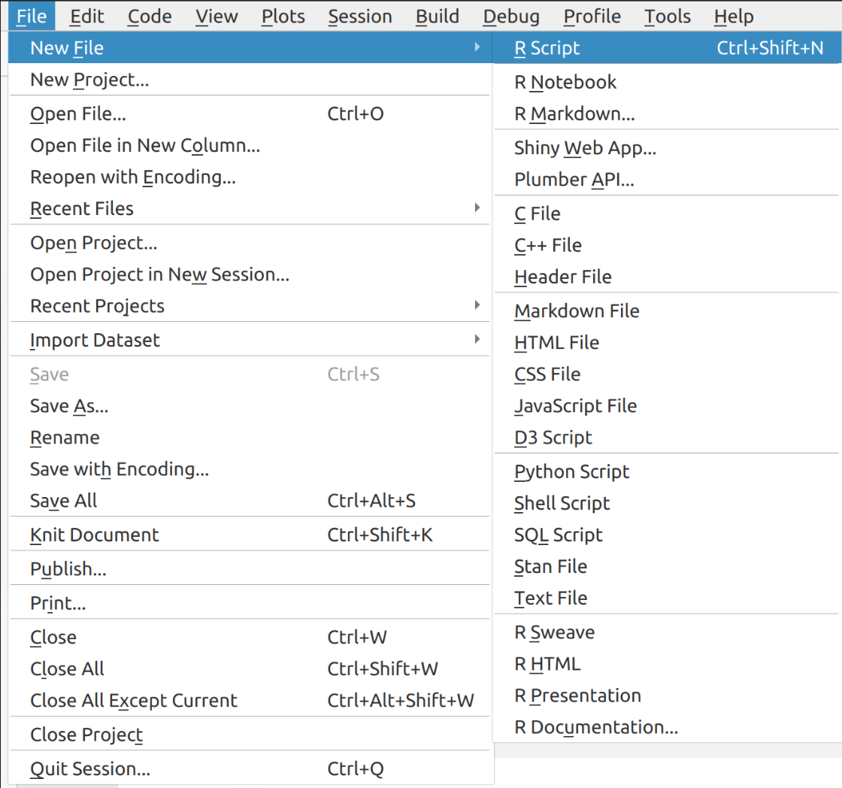
Creating a script

Slide 12
Programming basics of R

Slide 13
Basic arithmetic operations
Addition:
6 + 8
Subtraction:
9 - 4
Multiplication:
5 * 3
Division:
6 / 2

Slide 14
Assigning values to variables
Restaurants <- 76
Restaurants

Slide 15
Data structures and data types
Data structures
A particular way of organizing data in a computer so that it can be used effectively.
Vector
Collection of elements mostly character, logical, integer or numeric.
sub_counties <- c("Makueni","Kaiti","Kilome","Kibwezi East","Kibwezi West")
sub_counties

Slide 16
2. List
Collection of elements mostly of different data types
makueni <- list(c("Agriculture","Education","Climate"),c(2341,1345,345,44),TRUE)
makueni

Slide 17
3. Matrix
A type of data structure that is simply an atomic vector with dimensions. Elements of a matrix must be of the same data type.
my_matrix <- matrix(c(1,2,3,4,5,6), nrow = 2, byrow = TRUE)
my_matrix

Slide 18
4. Dataframe
A special type of list where every element of the list has same length (think of it as a rectangular list).
Makueni_subcounties <- data.frame(
subcounties = c("Makueni","Kaiti","Kilome","Kibwezi East","Kibwezi West"),
population = c(1243,2455,6762,2422,7865)
)

Slide 19
5. factors
In R, factors are used to work with categorical variables, variables that have a fixed and known set of possible values
month_levels <- c( "Jan", "Feb", "Mar", "Apr", "May", "Jun",
"Jul", "Aug", "Sep", "Oct", "Nov", "Dec")
mx <- c("Dec", "Apr", "Jan", "Mar")
mx_factor <- factor(mx,levels = month_levels)

Slide 20
Data types
character
subcounty <- “Kilome”
typeof(subcounty)

Slide 21
2. numeric
area <- 653.2
typeof(area)

Slide 22
3. integer
area <- 3L
typeof(area)
Note: L tells R to store 3 as an integer, otherwise it will be stored as a numeric

Slide 23
4. logical
male <- TRUE
typeof(male)

Slide 24
5. complex
v <- 3 + 2i
typeof(v)

Slide 25
Packages
A package is a collection of R functions, compiled code and data. They are stored under a directory called 'library' in the R environment. By default, when you install R, It comes with a set of packages which are loaded everytime you start your R. You can install other packages, however, for such packages you will have to load/call them into R interface everytime you want to use them.

Slide 26
Installing a new package
install.packages("Package name")

Slide 27
# example - installing ggplot2
install.packages("ggplot2")

Slide 28
Loading your package
After you've installed a package you need to load/call it into R environment to use it. You do this as shown below;
library(ggplot2)

Slide 29
Assignment:
Install and load a package called dplyr

